Slide 1
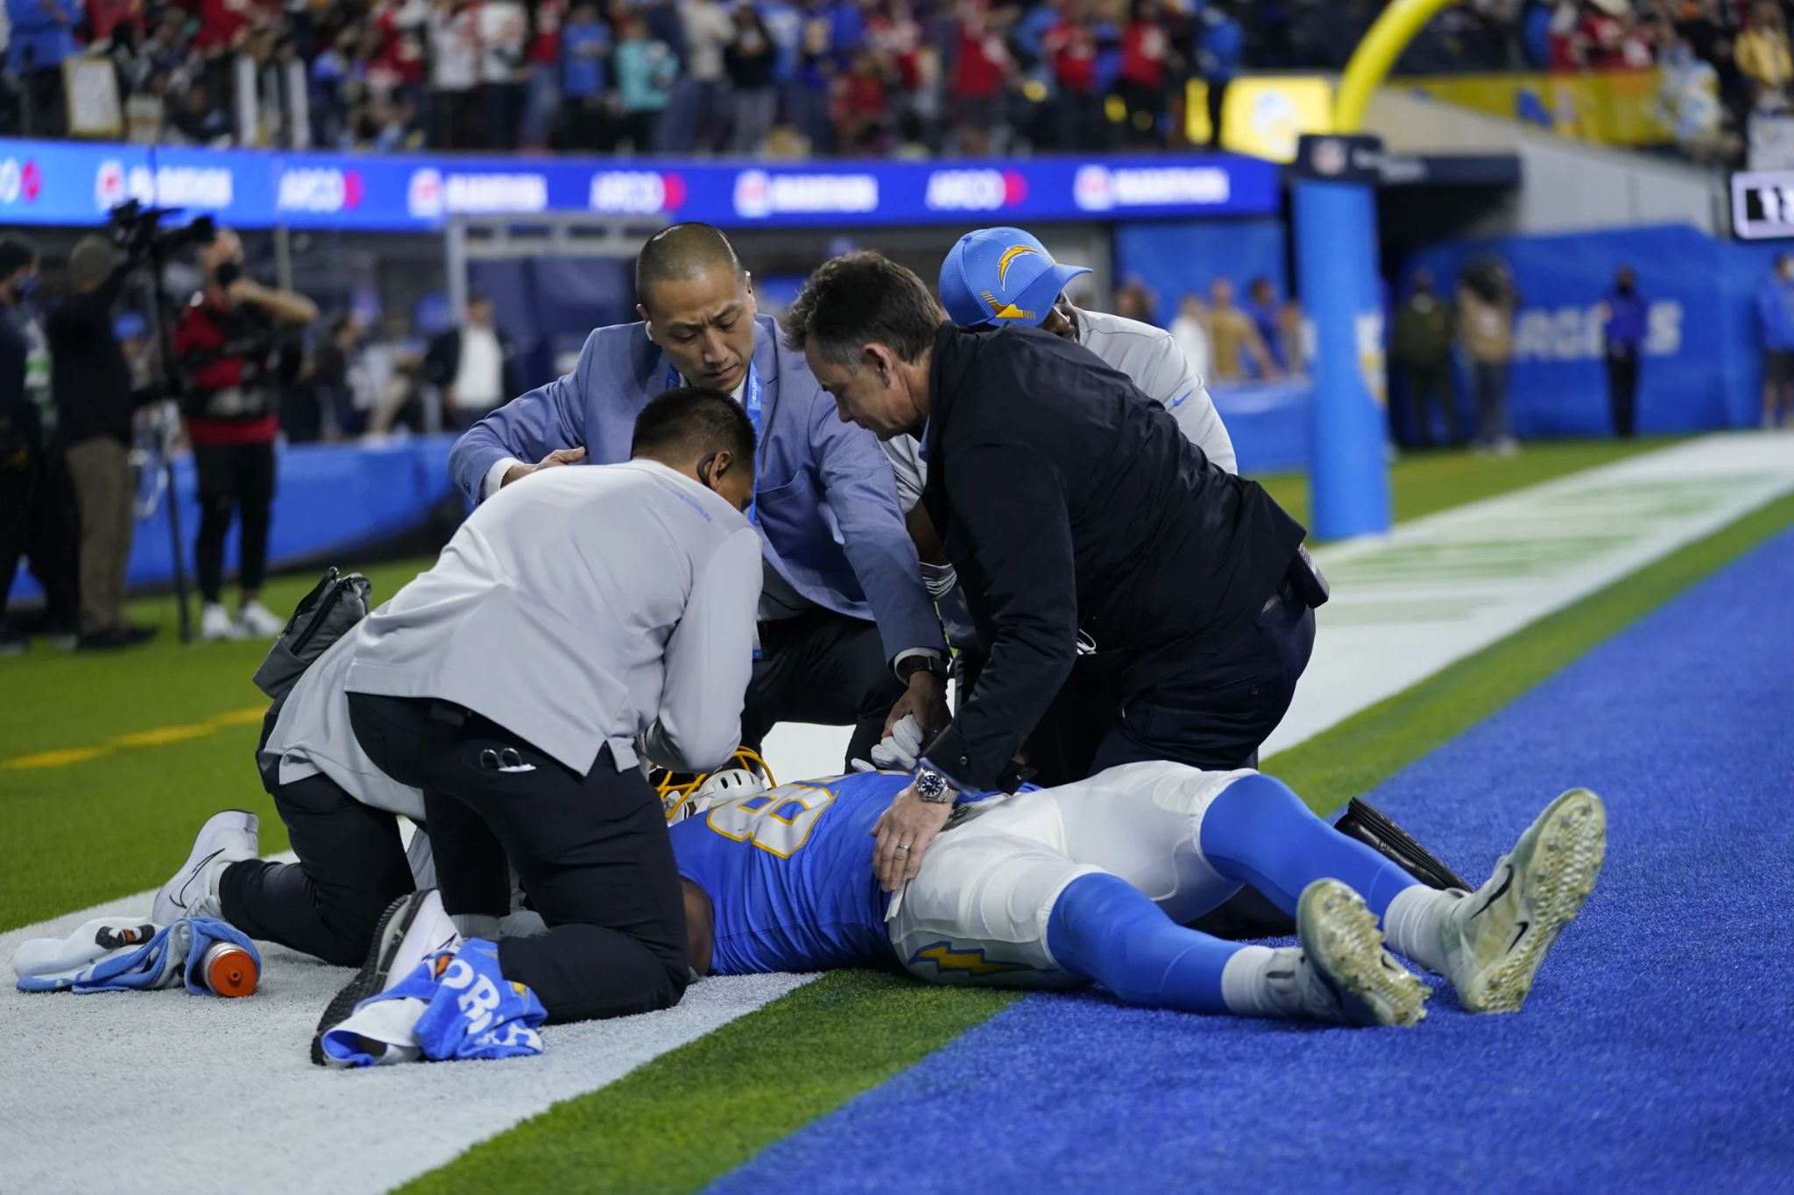
NFL Rest Days Effects on Injuries
Malcolm Gaynor & Will Gibbs

Slide 2
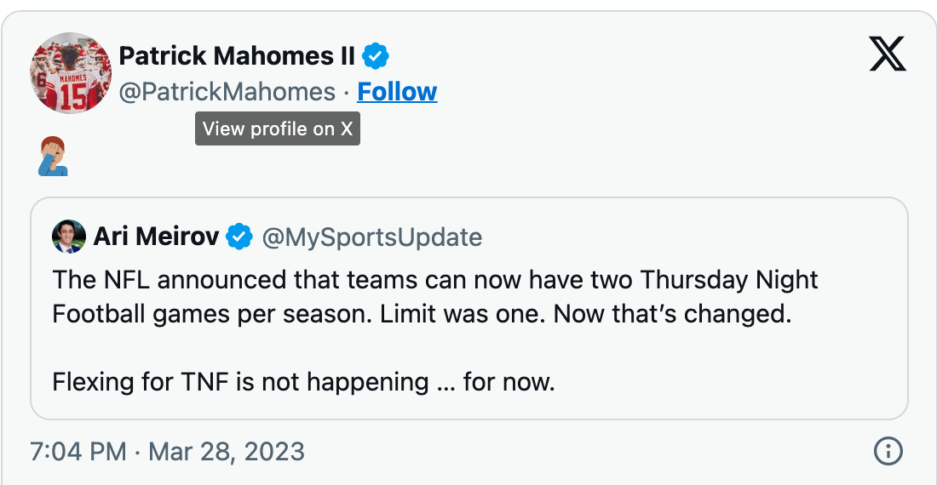
Motivation
Patrick Mahomes, Christian McCaffrey, Devin McCourty, and Richard Sherman have all criticized Thursday Night Football Games
There are only 4 days between Sunday and Thursday games
However, the literature finds that Thursday Night Football games have LESS injuries:
National Institute of Health
https://pubmed.ncbi.nlm.nih.gov/30848976/#:~:text=Results%3A%20The%20all%2Dcause%20injury,6%2C072%20per%201%2C000%20athletic%20exposures.
Orthopaedic Journal of Sports Medicine
https://journals.sagepub.com/doi/abs/10.1177/2325967119S00341

Slide 3
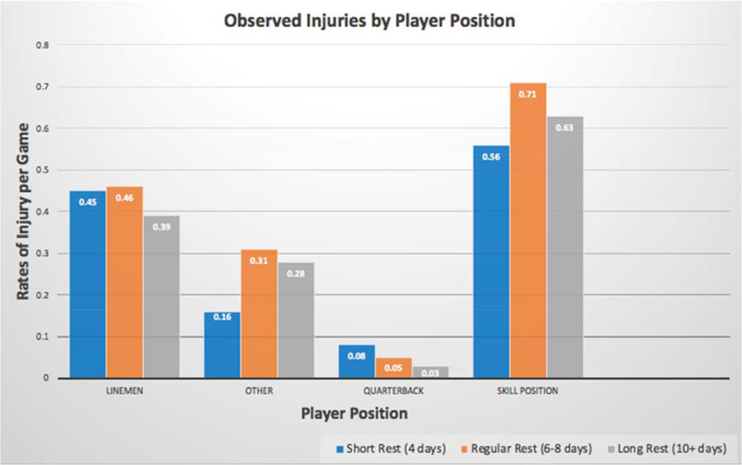
Problems with the Literature
Both research articles use a categorical independent variables
Days of rest: short (4 days) vs. regular (6-8 days) vs. long (10+ days)
Night of game: Thursday vs. Sunday vs. Monday
However, days of rest can be a QUANTITATIVE variable
Also, this research does not consider other independent variables that could impact the data

Slide 4
Our data
(5:43) (SHOTGUN) 16-T.LAWRENCE SACKED AT CIN 30 FOR -7 YARDS (91-T.HENDRICKSON). JAX-16-T.LAWRENCE WAS INJURED DURING THE PLAY. HIS RETURN IS QUESTIONABLE.
NFL 2023 play-by-play data weeks 2-14
Injuries counted when they occur in the play description
Flawed data…
Other independent variables include Week, Rest days, Rush yards, Pass yards, Total yards, Points scored, percent of yards that are rush yards, surface (turf or grass)

Slide 5
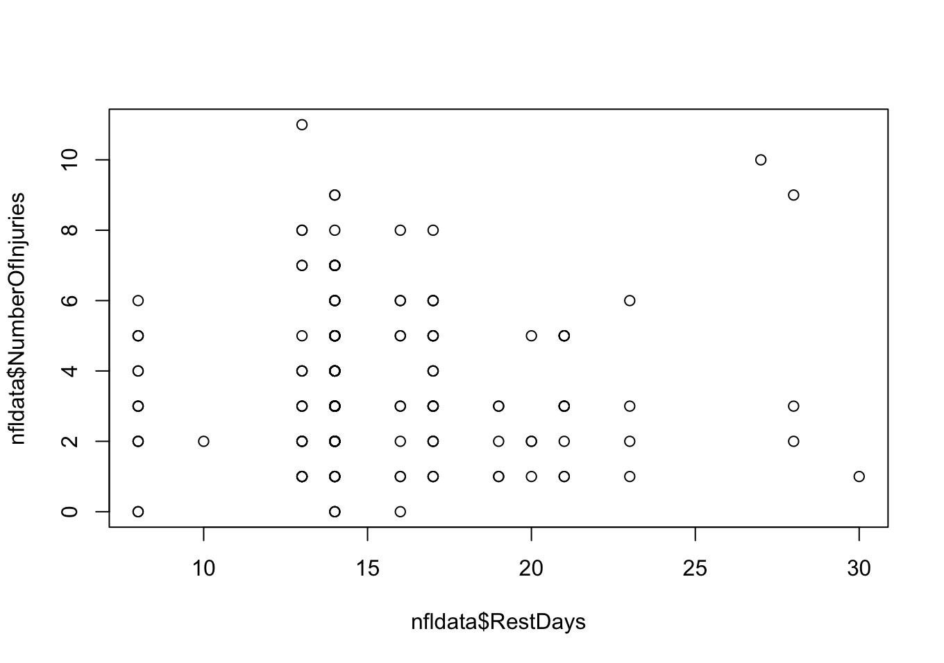
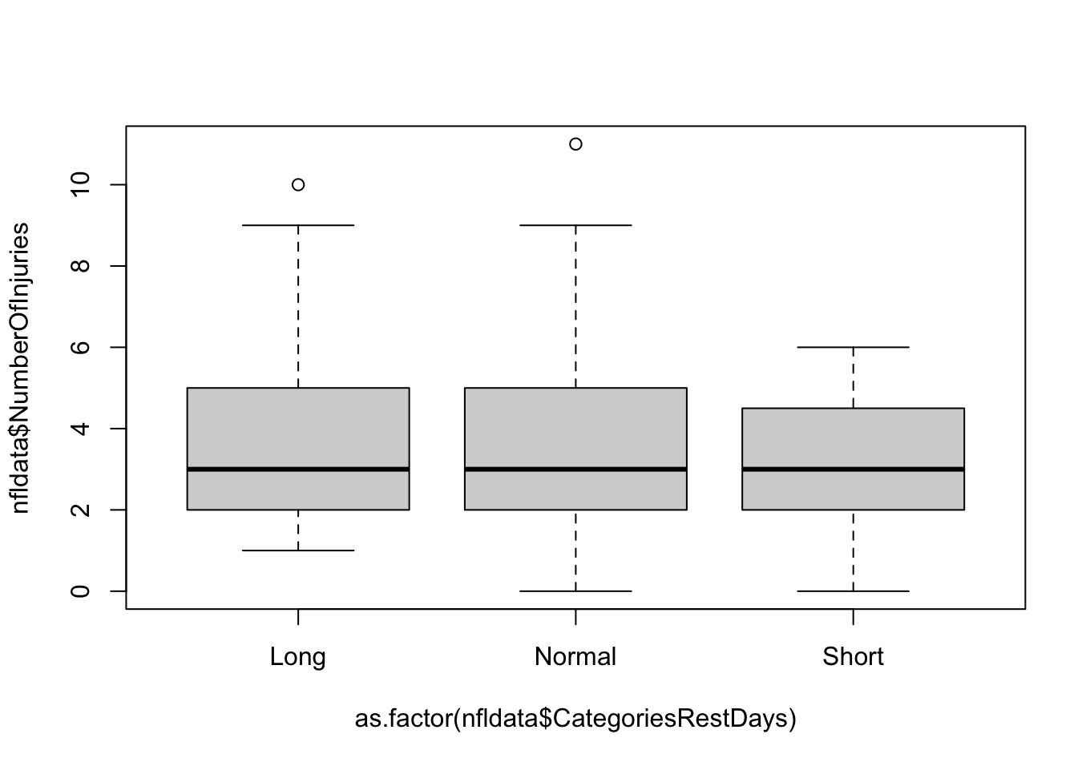
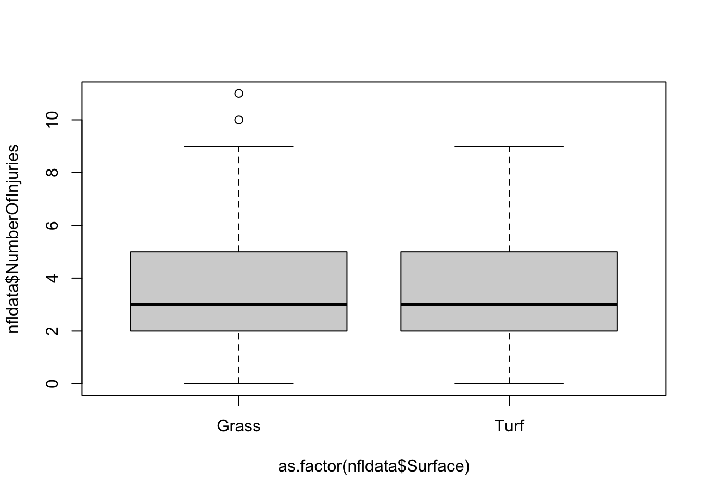
Exploratory data analysis
Initially, rest days (and all independent variables) do not appear significant

Slide 6
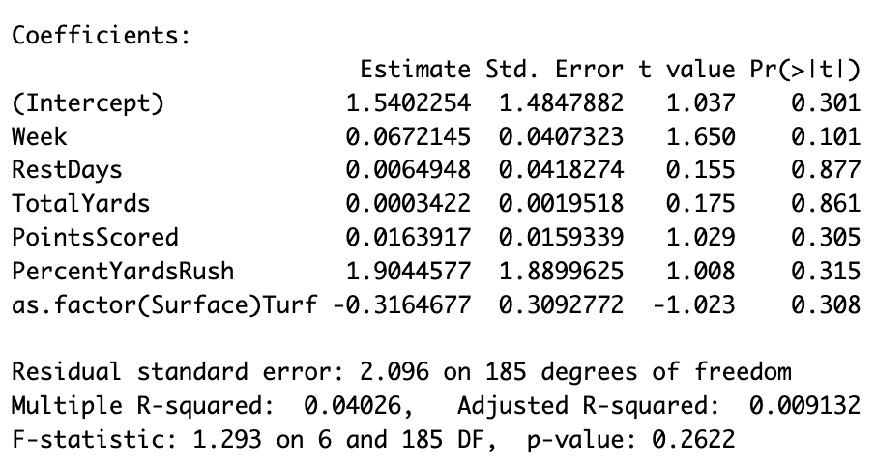
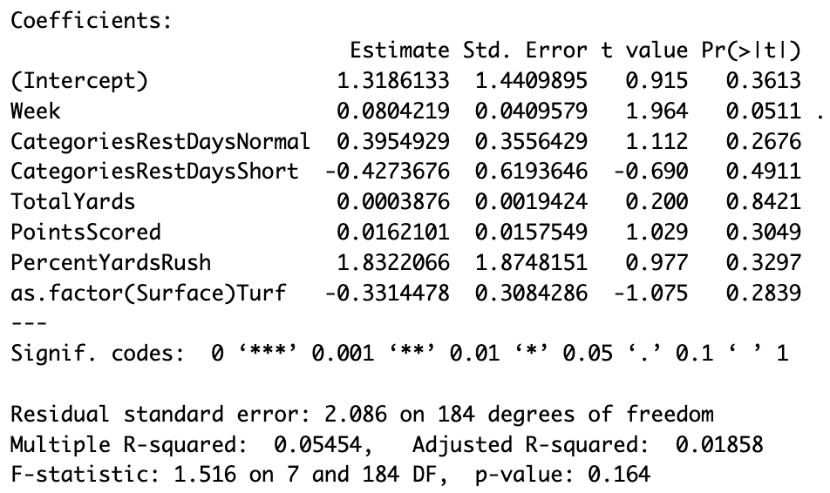
Linear Regression (full model)
One model treated rest days quantitatively, another treated rest days categorically.

Slide 7
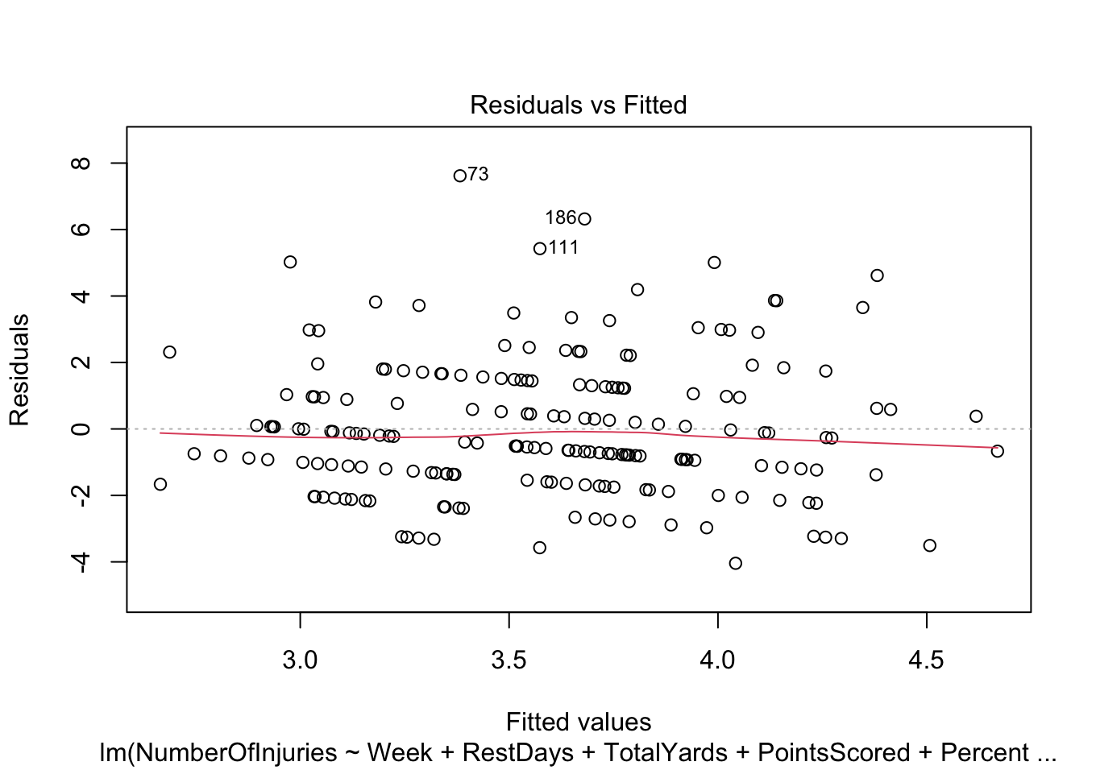
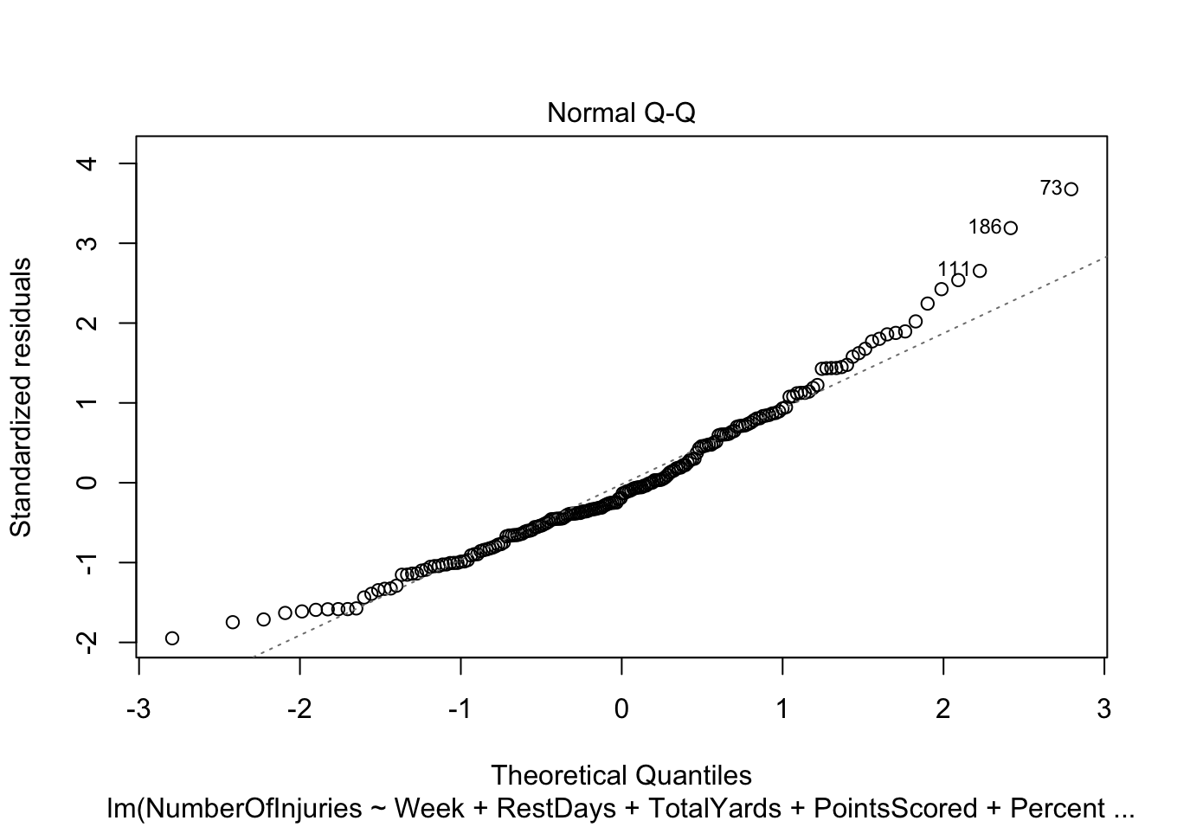
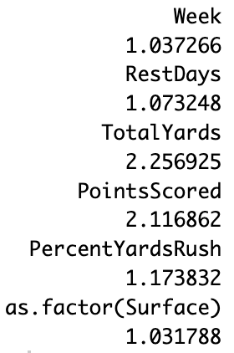
Conditions (continuous model):

Slide 8
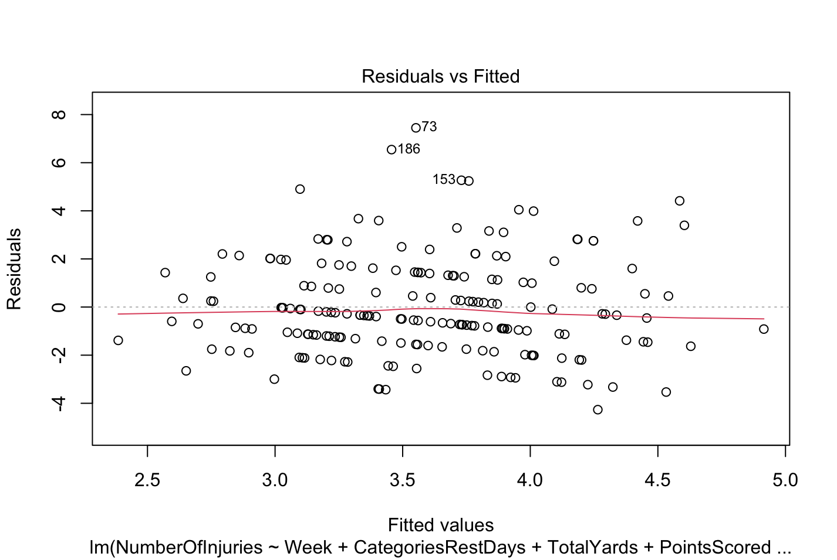

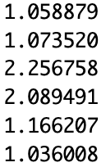
Conditions (categorical model):
VIF:

Slide 9
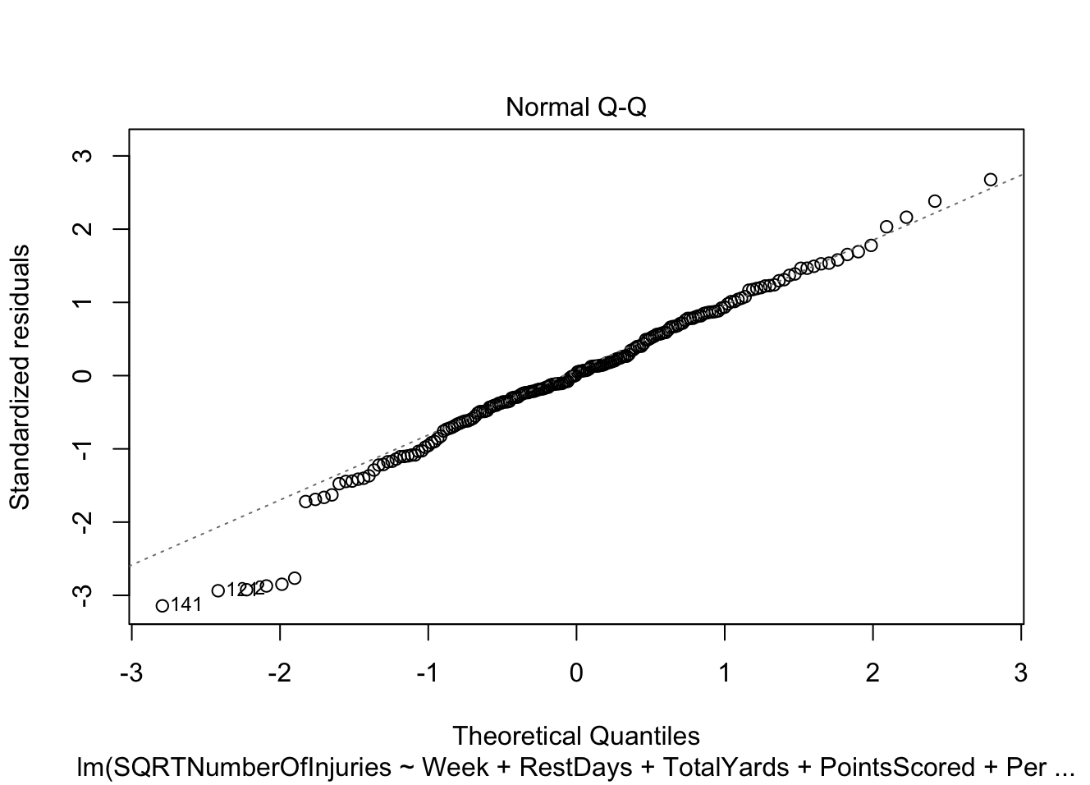
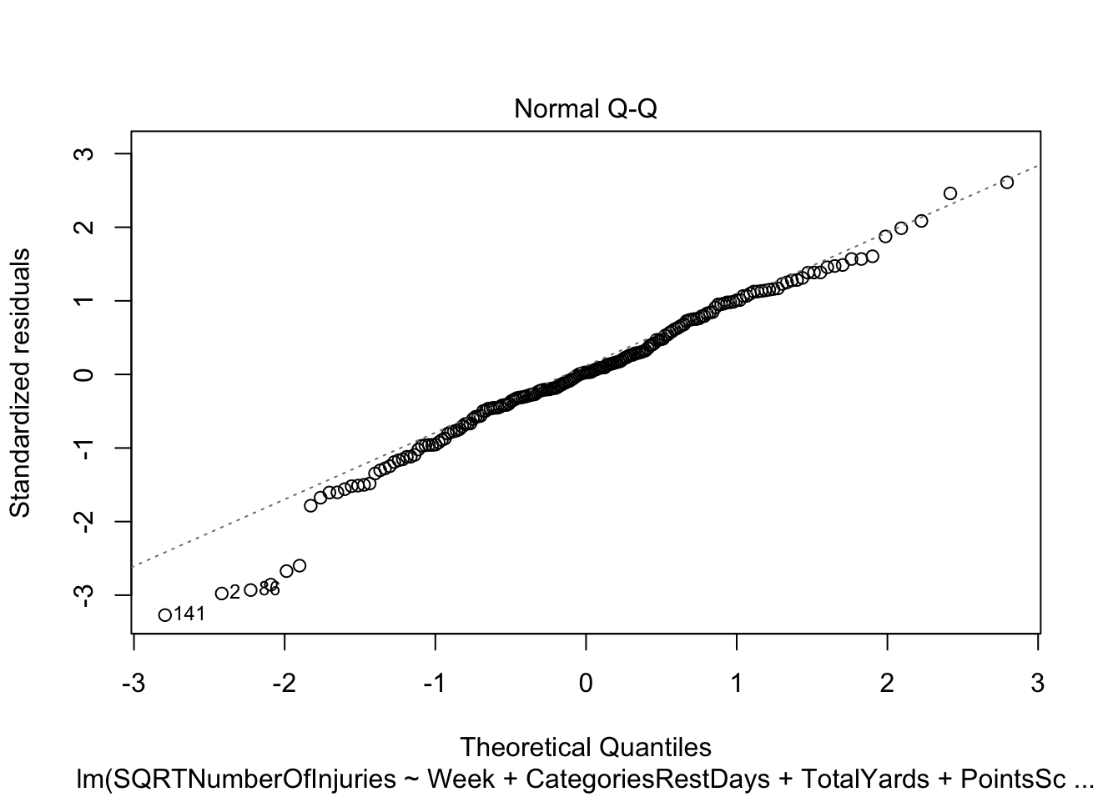
Normal QQ-plots after square root transformation of injuries:

Slide 10
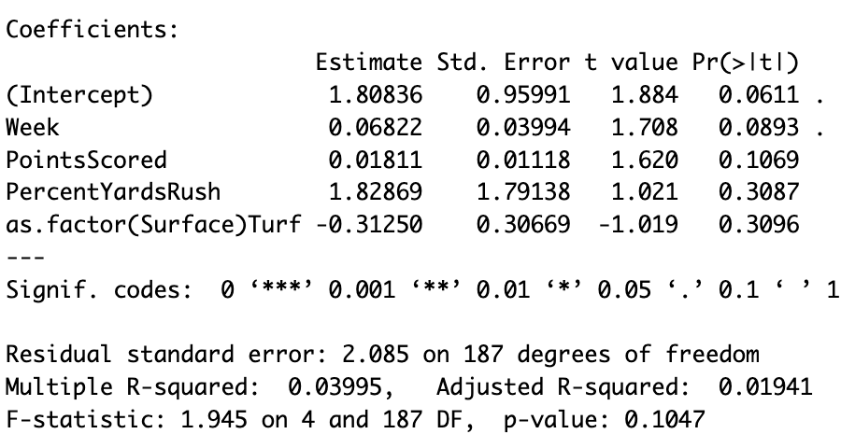
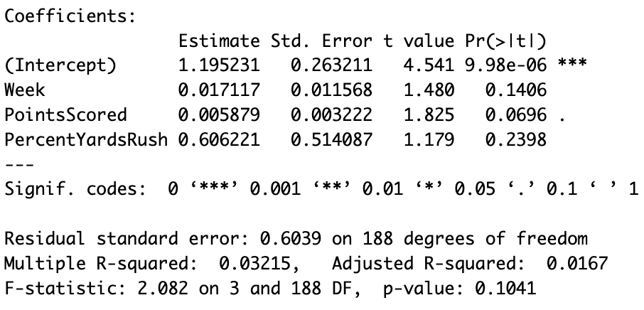
Best subsets model selection
Quantitative days of rest for number of injuries and square root of number of injuries
Days of rest not included in either model

Slide 11
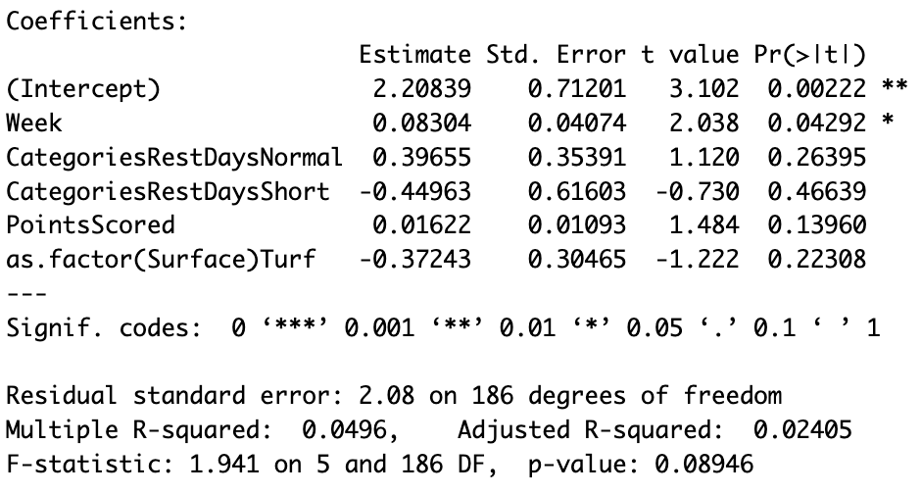
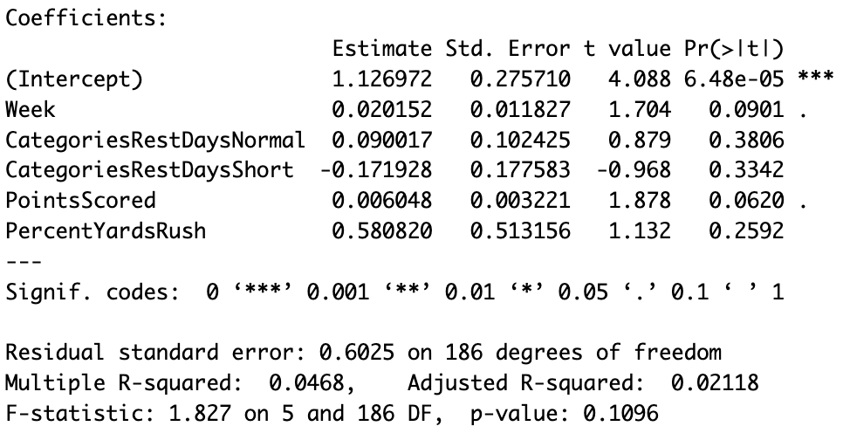
Best subsets model selection
Categorical days of rest for number of injuries and square root of number of injuries
Days of rest included in both models

Slide 12
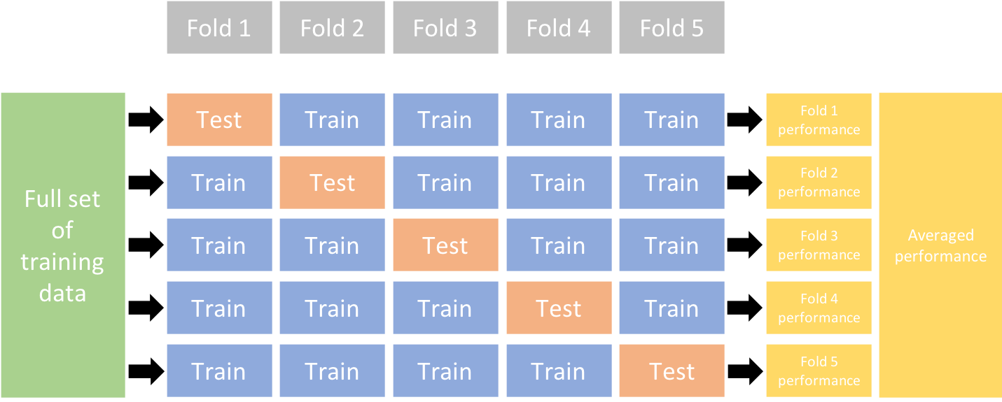
K fold cross validation to compare models
Method for splitting up data into test and training sets
RMSE- error in the units of response variable (number of injuries). Objective is to minimize.

Slide 13
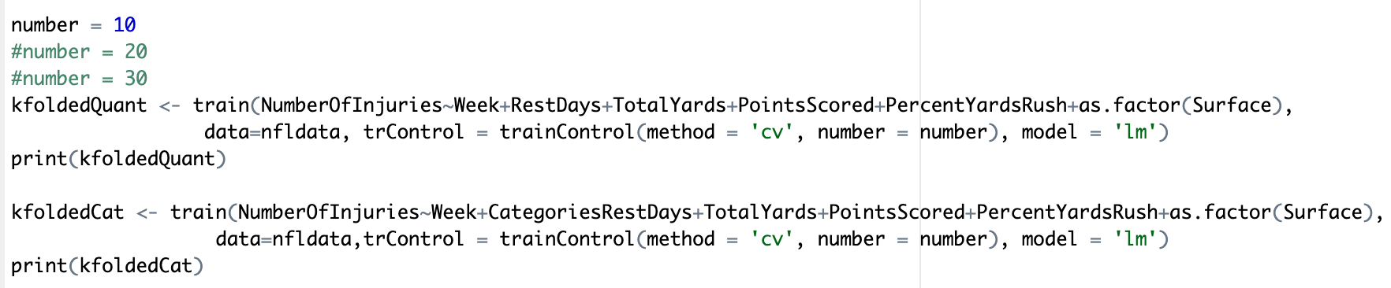
R code
10, 20, and 30 folds
Key output: RMSE- error in the units of response variable (number of injuries). Objective is to minimize.

Slide 14
Output
RMSE values minimized for categorical injuries, but still large contextually
R-squared values still always tiny (well below 0.1)
RMSE Chart | 10 folds | 20 folds | 30 folds
Quantitative Rest Days | 2.135284 | 2.107371 | 2.106220
Categorical Rest Days | 2.114944 | 2.095337 | 2.052833

Slide 15
Conclusions from linear analysis
We concur with the literature that days of rest is not a significant predictor of injuries
We find no evidence that treating days of rest as a categorical variable was misleading
Next, we will consider some non-linear analysis

Slide 16
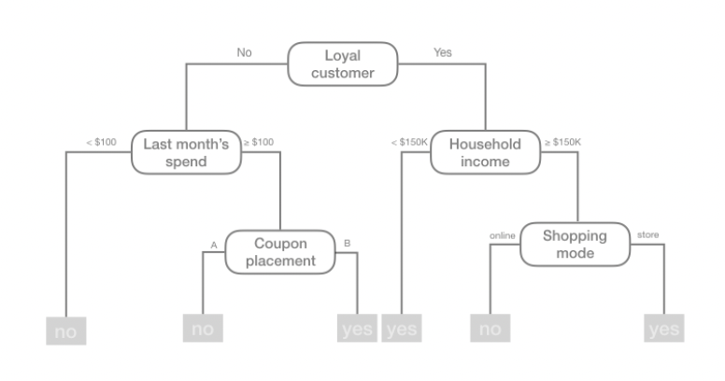
Decision Trees
Use binary splitting rules
Such divide and conquer methods result in simple rules well illustrated with tree diagrams
Can be viewed as a piecewise constant approximation

Slide 17
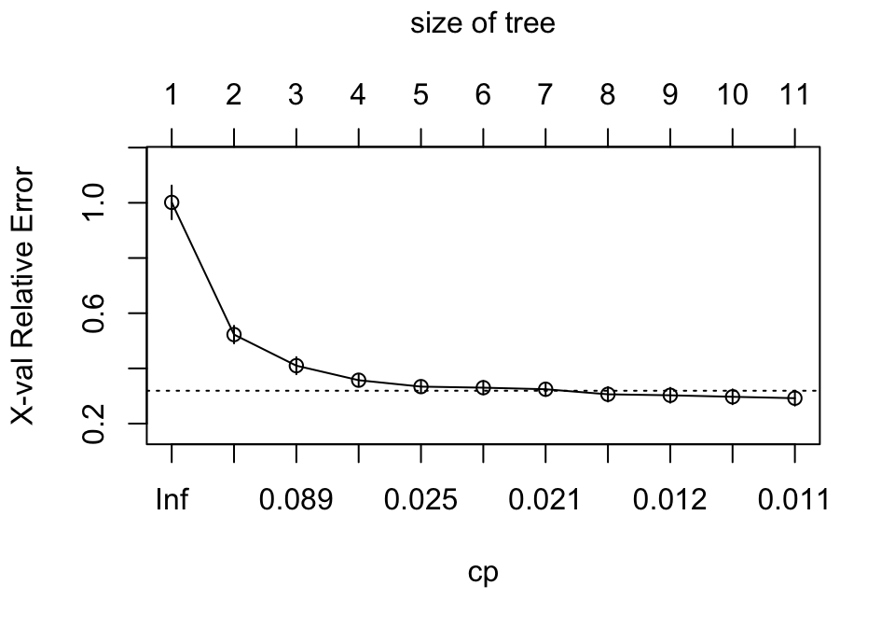
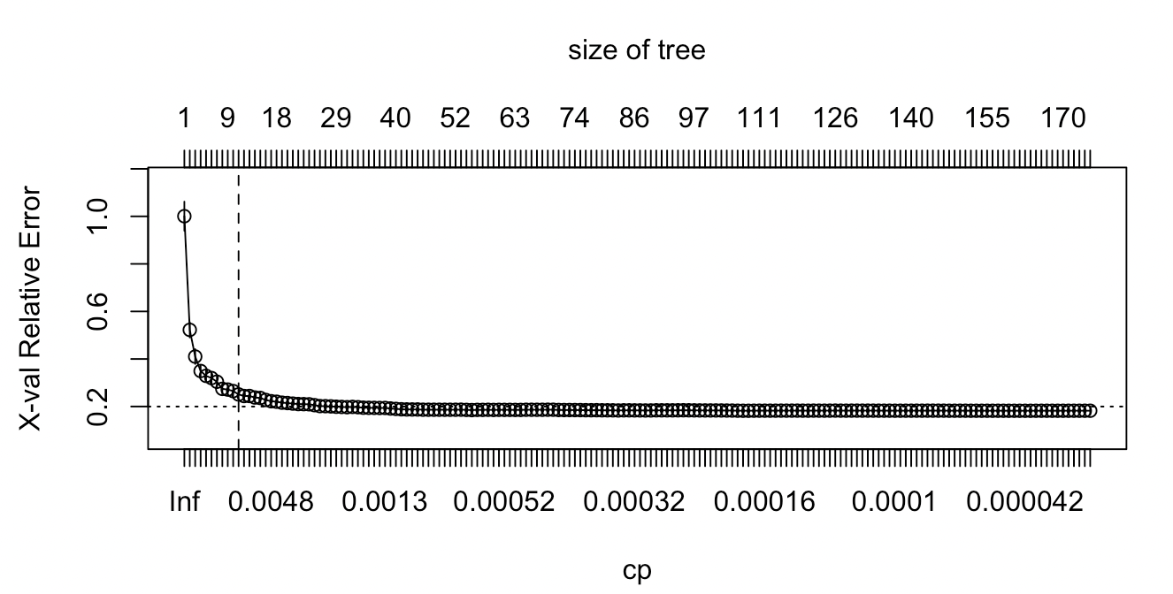
When to Stop Splitting a Tree?
If too many nodes the tree won’t generalize as well
Less branches might not capture all interactions
Less variance with more nodes
Pruning Complexity Parameter Plot
Prune - continue until diminishing returns
CP - probability to produce an output within certain boundaries
Dashed line represents smallest tree within 1 standard error of the minimum CV error

Slide 18
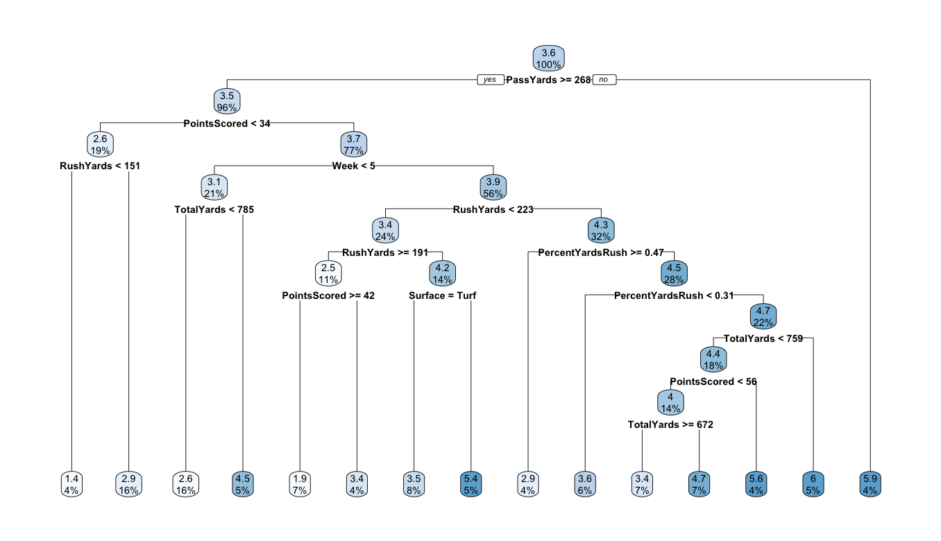
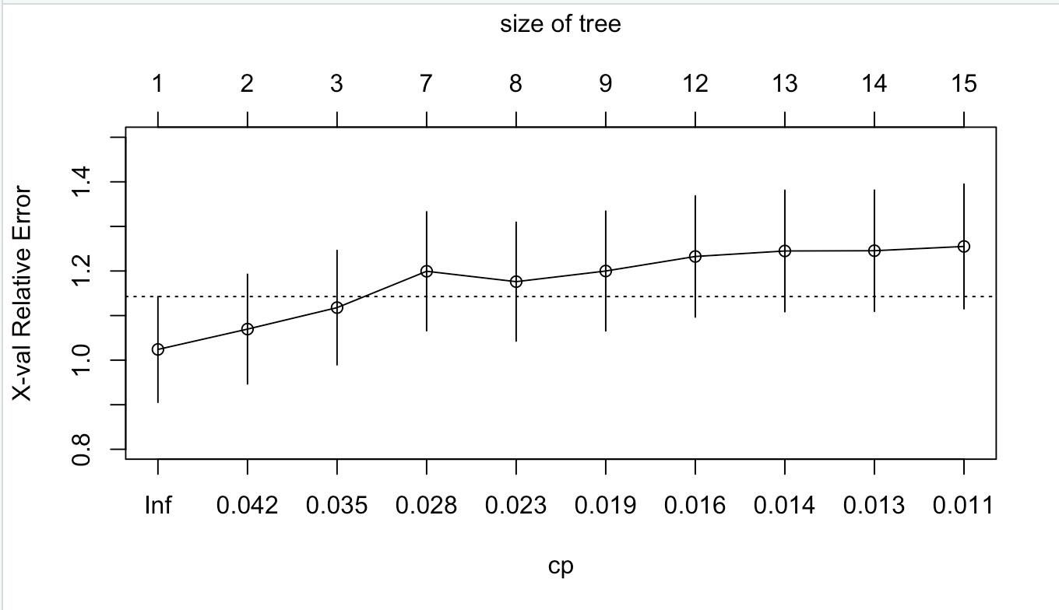
Our Decision Tree
Same for categorical and quantitative rest day models
Generally the higher the node the more important it is

Slide 19
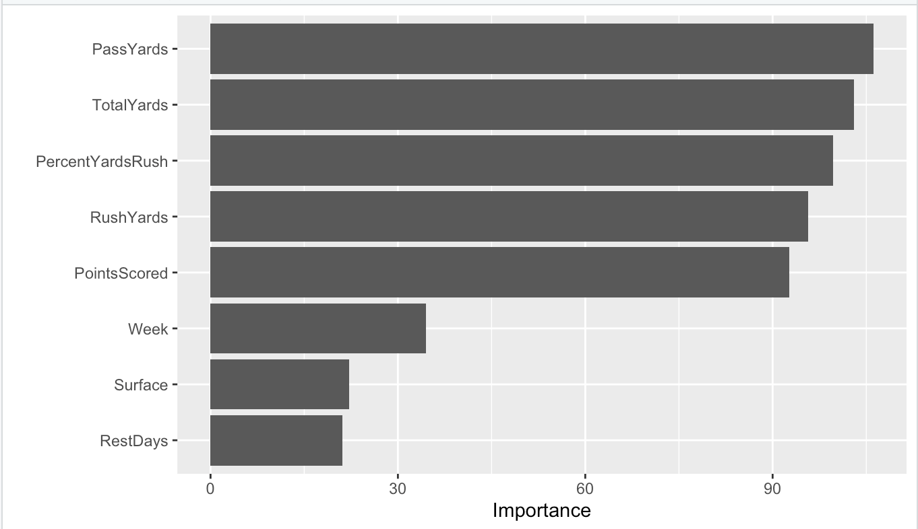
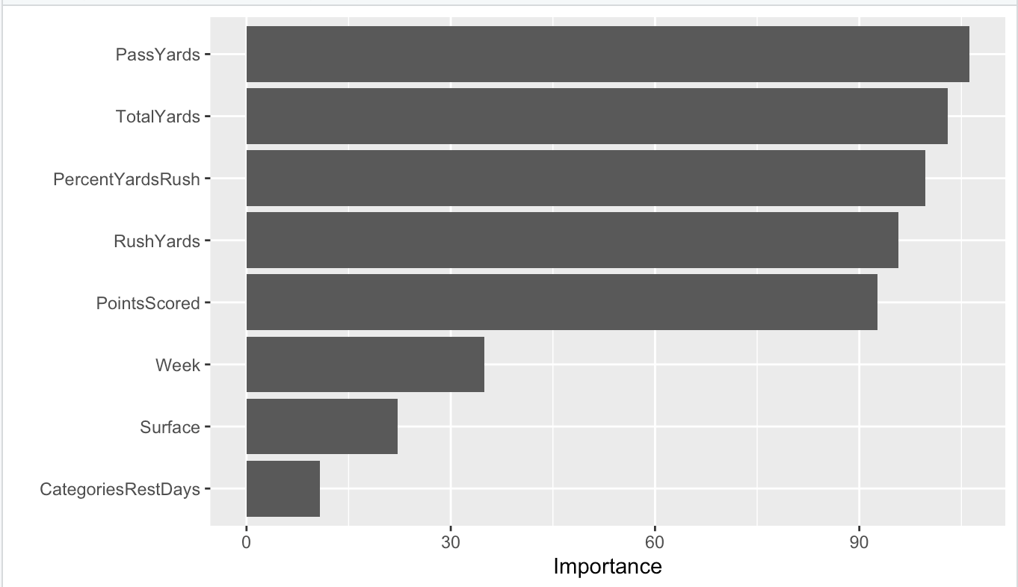
Importance of Predictors

Slide 20
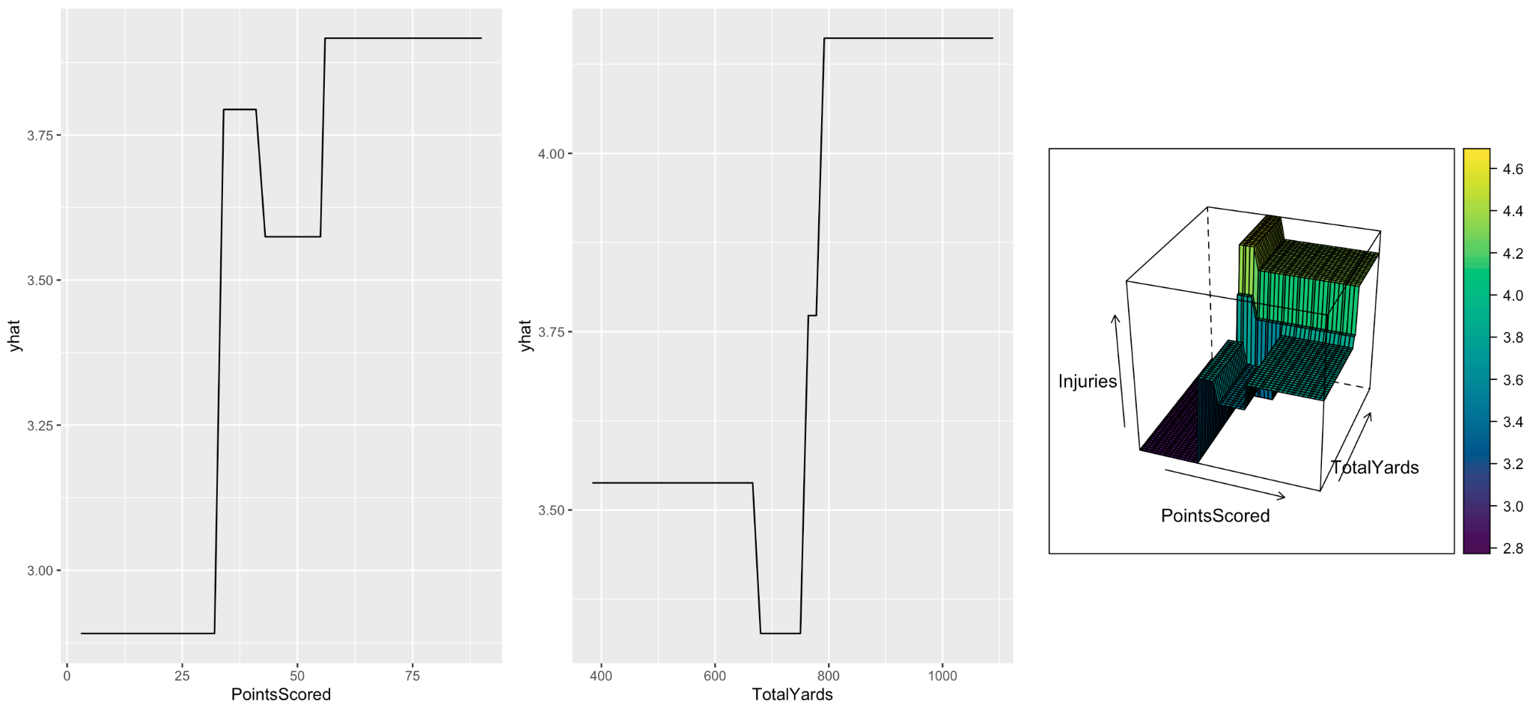
Problems with Decision Trees
Lack in predictive performance relative to more complex algorithms such as neural networks and MARS
Rather staggered in approach
Greedy algorithm
More powerful ensemble algorithms include decision trees such as random forests and gradient boosting machines

Slide 21
If We Had More Time
Expand on other linear models (such as rank-based regression)
Expanded our data as not to “overfit” such a small sample, or just found a better dataset
Explored potential correlations within our Decision Tree
Tried a more advanced ensemble algorithms, such as random forests, gradient boosting machines, and bagging
Specialize based on types of injuries or position groups

Slide 22
Sources
https://sports.yahoo.com/chargers-te-donald-parham-unconscious-chiefs-nfl-014744061.html
https://pubmed.ncbi.nlm.nih.gov/30848976/#:~:text=Results%3A%20The%20all%2Dcause%20injury,6%2C072%20per%201%2C000%20athletic%20exposures.
https://journals.sagepub.com/doi/abs/10.1177/2325967119S00341
https://www.si.com/nfl/2023/03/29/kansas-city-chiefs-patrick-mahomes-disapproval-thursday-night-football-change
https://sotsports.com/2021/11/28/nfl-thursday-night-football-alternatives/
https://nflsavant.com/about.php
https://www.pro-football-reference.com/
https://bradleyboehmke.github.io/HOML/

Slide 23
Questions?

